Slide 1
Financial Impact of Social Media Ranking
Harshitha ram gopal

Slide 2
PROBLEM
Does a change in TripAdvisor ranking affect revenue of the hotel
Predict hotel revenue for a particular time period using TripAdvisor ranking and other available attributes

Slide 3
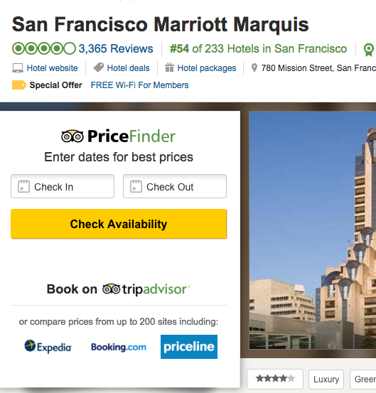
BACKGROUND
TripAdvisor ranking is based on quantity, quality and age of reviews.
Studies show how to improve this ranking and how a change in overall score on social media can justify increase in room rates.

Slide 4
DATA
Hotel Name, Rank, Rank Size, Month, Year collected every month from TripAdvisor for the last 3 years for one brand in Orlando
Average Room Rate, Occupancy Rate, # of Rooms collected from hotel

Slide 5
DATA WRANGLING
Monthly Revenue calculated from ADR,OCC,# of rooms
TripAdvisor rank re-adjusted to locality and chain scale
geopy package to cluster hotels based on distance.
Considered one chain scale above and below hotel to cluster based on chain scales.

Slide 6
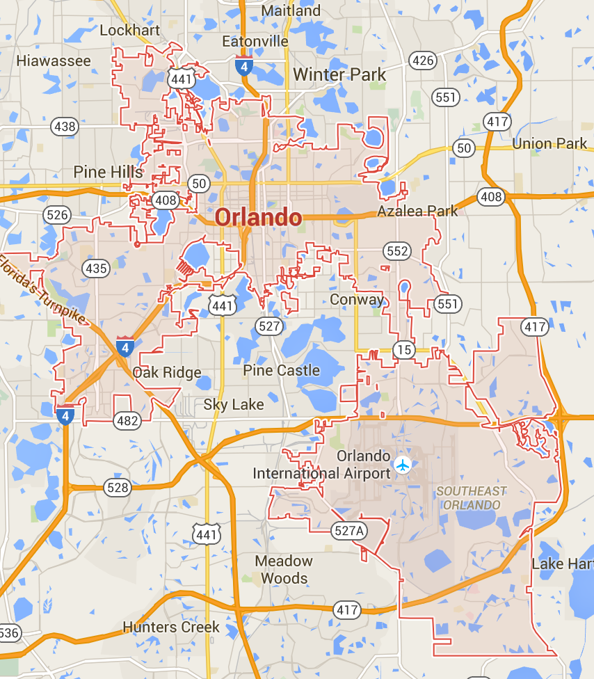
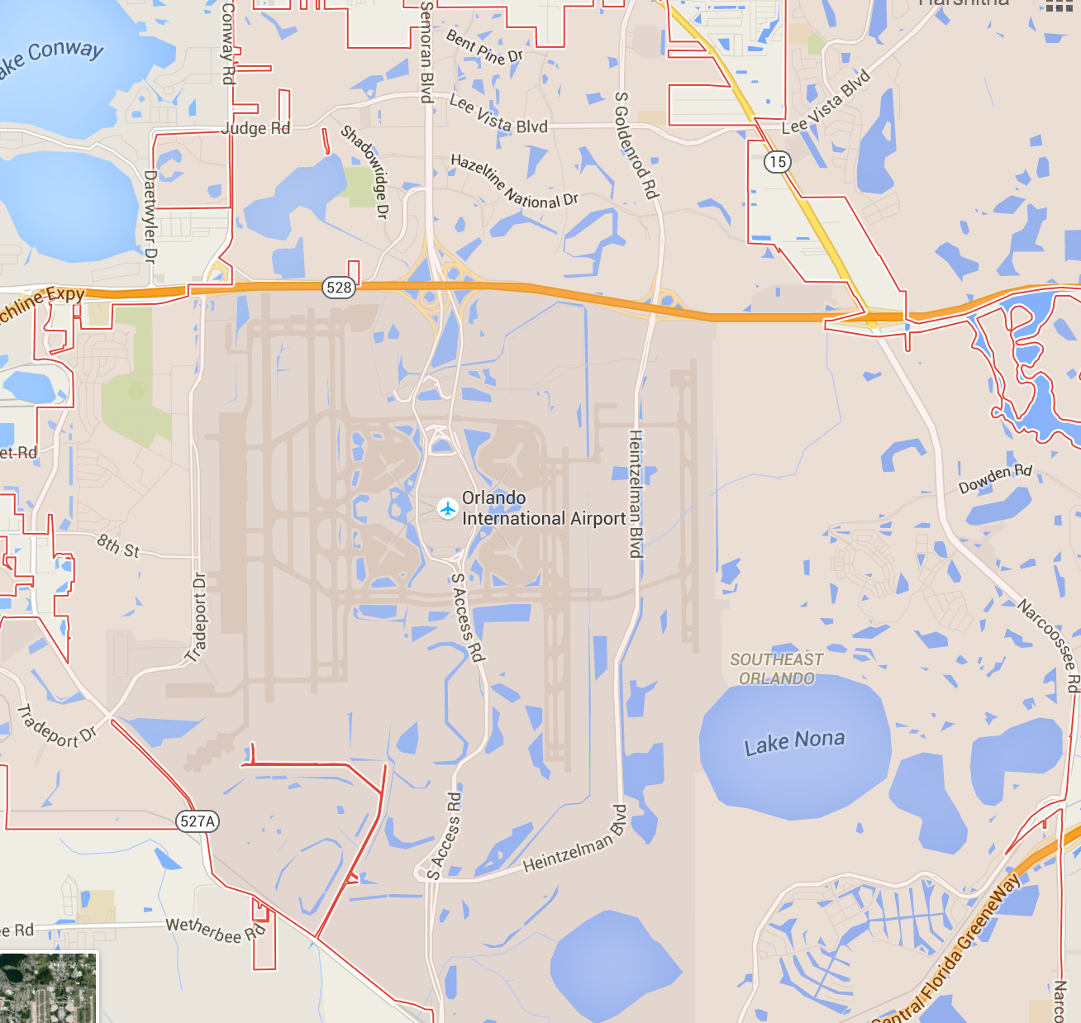
RANKING CONVERSION
58/367
20/78
7/39

Slide 7
FEATURES FEATURED
Initial Data Set
TID
MONTH
YEAR
HOTEL NAME
RANK
RANK SIZE
ADR
OCC
# Rooms
X
TID
QUARTER
YEAR
BRAND
RANK_BY_SIZE
X
TID1, TID2, ..
Q2,Q3,Q4
Y2013, Y2014
LUXURY, UPSCALE, etc.
RANK_BY_SIZE
Category to Dummy
Other
ADR, OCC, # Rooms
Y
REVENUE

Slide 8
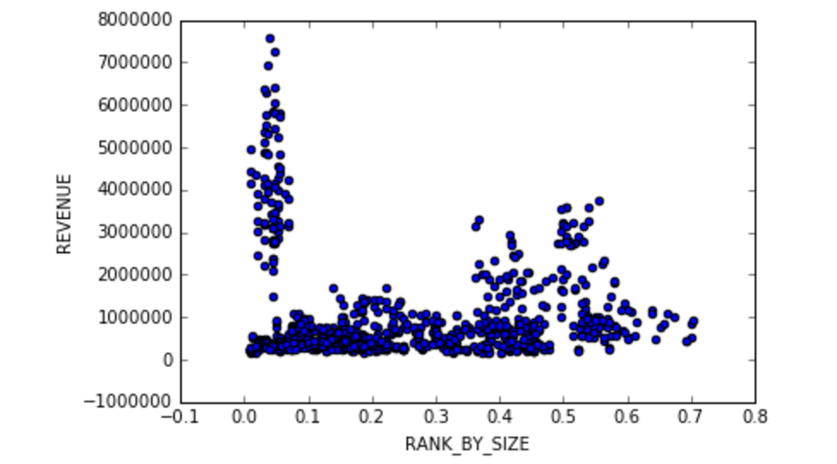
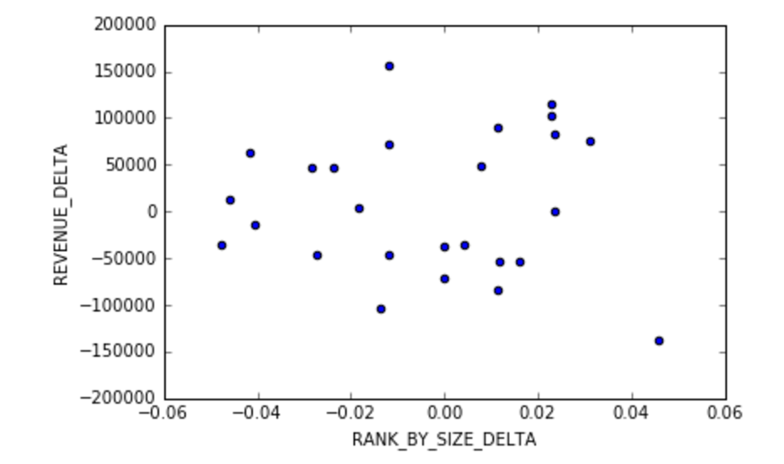
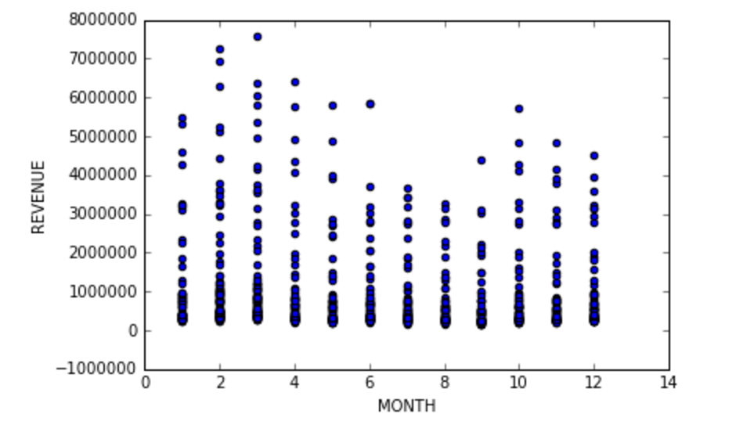
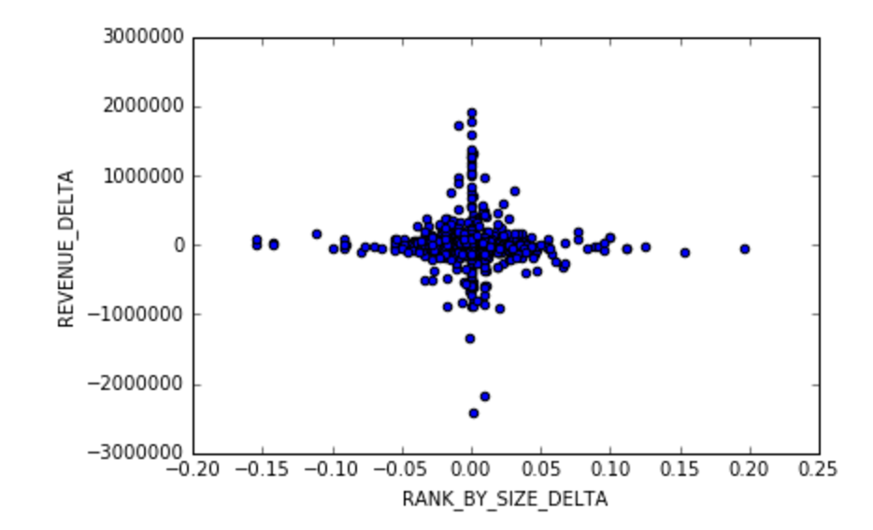
Revenue by Normalized Rank
INITIAL
OBSERVATIONS
Revenue and Rank Difference for one month
Revenue by Month
Revenue by Rank difference

Slide 9
Interpretation - Model Selection
Linear Regression Model was selected due to its high interpretability
Feature Selection
TID , Month, Year, Rank, Rank_Size, Rank_By_Size
High R² (0.91)
TID was highly significant but other features were not significant
Month, Year, Rank, Rank_Size, Rank_By_Size
Low R² (0.03)
Rank_Size and Rank_by_Size were significant
Quarter, Year, Rank_By_Size, Chain Scale
Medium R² (0.33)
All features were significant

Slide 10
Linear Regression
Revenue =
3,351,000 - 967,321 * Rank_by_size
- 226,222 * Y_2013 - 123,340 * Y_2014
- 115,186 * Q2 - 343,294 * Q3 - 165,692 * Q4
- 2,569,240 * Upper_Mid - 975,895 * Upper_Up - 2,104,390 * Upscale
Notes:
Talk about significance here

Slide 11
RANK_BY_SIZE
Ex: Move from Rank 1 to end of the line
$967,321 in Monthly Revenue

Slide 12
Next Steps
Group by rank ranges to understand if the revenue changes for all rank changes in all ranges.
Group data into different chain scales to understand if this phenomenon is across the board.
Gather more features to control for variability

Slide 13
Prediction – Model Selection
Random Forest was selected due to its high predictability
TID , Quarter, Year, Pre_Rank_By_Size (k-1 dummy)
OOB Score – 0.91
MSE -
Trees – 1000 Features – 13
Brand, Quarter, Year, Pre_Rank_By_Size (k-1 dummy)
OOB Score – 0.81
MSE – 840,500 -> $916
Trees - 1000 Features - 3
Brand, Quarter, Year, Pre_Rank_By_Size (k dummy)
OOB Score - 0.83
MSE - 828,000 -> $909
Trees - 1000 Features - 4
Features/3 consistently performed well for all the regression models here

Slide 14
Feature Importance
Feature | Importance
Pre Rank/Size | 0.52849
Upper Upscale | 0.19800
Upper Midscale | 0.13726
Upscale | 0.08868
Q2 | 0.02022
Y_2013 | 0.00962
Y_2014 | 0.00703
Q4 | 0.00640
Q2 | 0.00430
Feature | Importance
Pre Rank/Size | 0.49121
Upper Upscale | 0.20404
Upper Midscale | 0.10771
Upscale | 0.07351
Luxury | 0.06556
Q1 | 0.01813
Q3 | 0.01465
Y_2015 | 0.00654
Y_2013 | 0.00640
Y_2014 | 0.00434
Q2 | 0.00416
Q4 | 0.00375
Model 2
Model 3

Slide 15
Next Steps
Use test/train instead of Cross-Validation to verify the result
Expand analysis to data from other brands and other cities

Slide 16
Thank you!

